Slide 1
Makers
and
Creators
Notes:
Welcome everyone to this week of makers and creators at campus north.

Slide 2
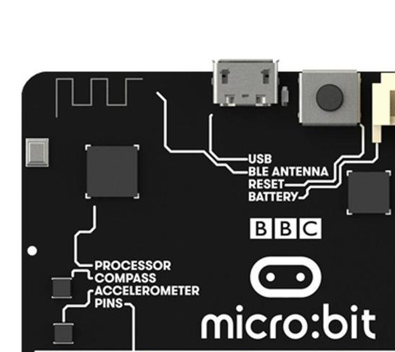
Monday
Notes:
Today we will be learning about the microbit

Slide 3
Why are we here?
Writing Code
Connecting hardware and software
Raspberry Pi and micro:bit
Minecraft

Slide 4
What would you
like to build?
Notes:
Friday project - think about what you would like to build.

Slide 5
Introducing…
Notes:
your mentors for today - each say who you are and what you do and what your favourite bit of computer science is.

Slide 6
Who are you?
The bit everyone hates :)
Who are you?
What do you know already?
What are you interested in?
Notes:
Start at one end of the room and ask each delegate to say something about themselves. Important early on to get everyone talking.

Slide 7
micro:bit?
Notes:
This is a relatively new hardware platform - a tiny board (a bit like the raspberry pi) but
with bluetooth, compass, tiny display, accelerometer.

Slide 8

Notes:
bbc video only if nobody knows what we are talking about.

Slide 9
A “Real” Machine
Tiny computer
Cheap & Robust
Choice of programming languages
USB or battery powered
Easy to get started

Slide 10
Simple &
Creative &
Complicated

Slide 11
Notes:
Margaret Hamilton - project lead for apollo guidance computer standing next to print out of the program.

Slide 12
More powerful than
the Apollo 11
computers
Notes:
microbit is more powerful than that computer and we don’t have to type out so much code.

Slide 13
Accelerometer
Display
Digital IO
Buttons
Radio
Notes:
Margaret would have loved the features that are built into the microbit.

Slide 14
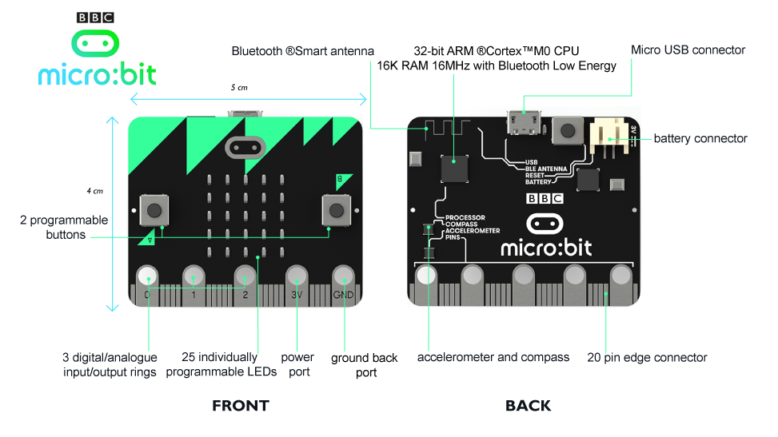
Notes:
This is what it looks like. Buttons and display on the front. Reset button and connector port on the back

Slide 15
python
Beginner friendly
Text-based
Simple syntax
Interpreted
Notes:
We will be using python for all our coding this week. Remind that it’s a good language to learn and many may have seen it already at school.

Slide 16
micro python
Lighter
Lower memory
micro:bit-specific functions
Notes:
Today we are using a slightly different version of python to run on the microbit.

Slide 17
micro punctuation
Punctuation
Indenting
Spacing
Spelling
Notes:
Remember punctuation and text is important!!!!

Slide 18
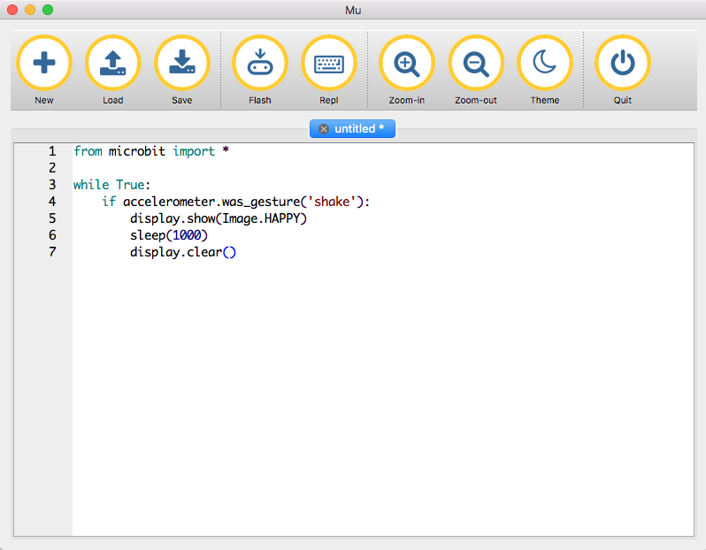
Notes:
Flash button is most important. Downloads program to device. Watch yellow light blink while that happens. The program will start to run. Or will show an error if it can’t make sense of the program.

Slide 19
micro:bit & python
Dedicated processing
Runs one program at a time - yours
Runs code (mostly) top to bottom
Does what you say, not what you think you said

Slide 20
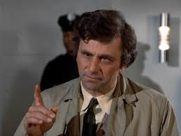
Errors
Python is interpreted
Errors shown one by one
Errors will scroll across the screen
(Can be) hard to read on device
Write them down (if you can)
Use the Reset button on the back
Notes:
microbit errors will scroll across the screen. they can be a bit difficult to read but if you lose the thread of what it’s trying to tell you, you can hit the reset button and it will try again.

Slide 22
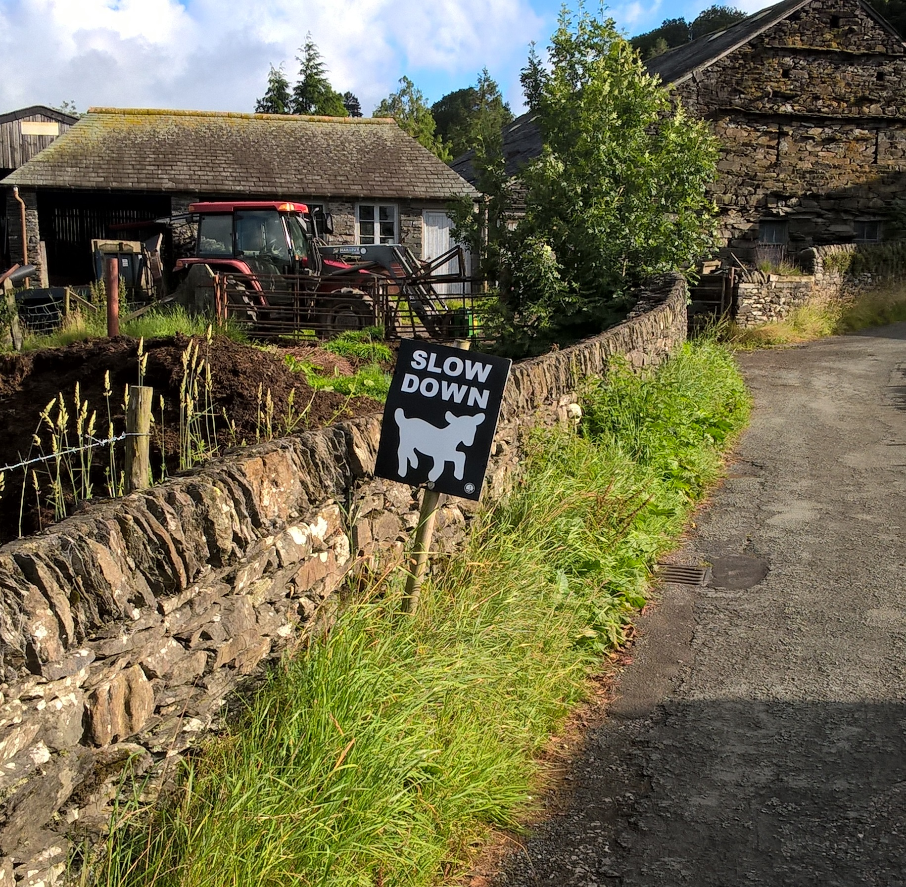
Our Process
Write a little bit of code
Download it (“Flash”)
See what it does
Repeat
Notes:
Where Scratch hid a lot of complexity behind snap together lego pieces, we
are going to be writing closer to actual instructions.
Where Scratch was interpreting our commands "live" and we could make changes that were instantly reflected in the behaviour of the program, Micro Python is a compiled language and follows a different lifecycle. We write code in text, we send the code down to the device where it is compiled into it's own internal representation, then the program executes.
This is faster to run and only needs to be downloaded once for each version, but it's not as reactive and live as Scratch.

Slide 23
Let’s get connected
Notes:
Plug cable into usb and plug other end into the port on the board. Don’t worry about touching it, you won’t get a shock and you won’t break anything.
The lead gives the unit power so keep it connected at all times.
Things to note - the display on one side. Two buttons left and right are a and b. The connector on the back and next to it a reset button. If everything is going wrong you can press that to restart your program.

Slide 24
Always
from microbit import *
Notes:
Always need this as the first thing in the program, even if we forget to mention.

Slide 25
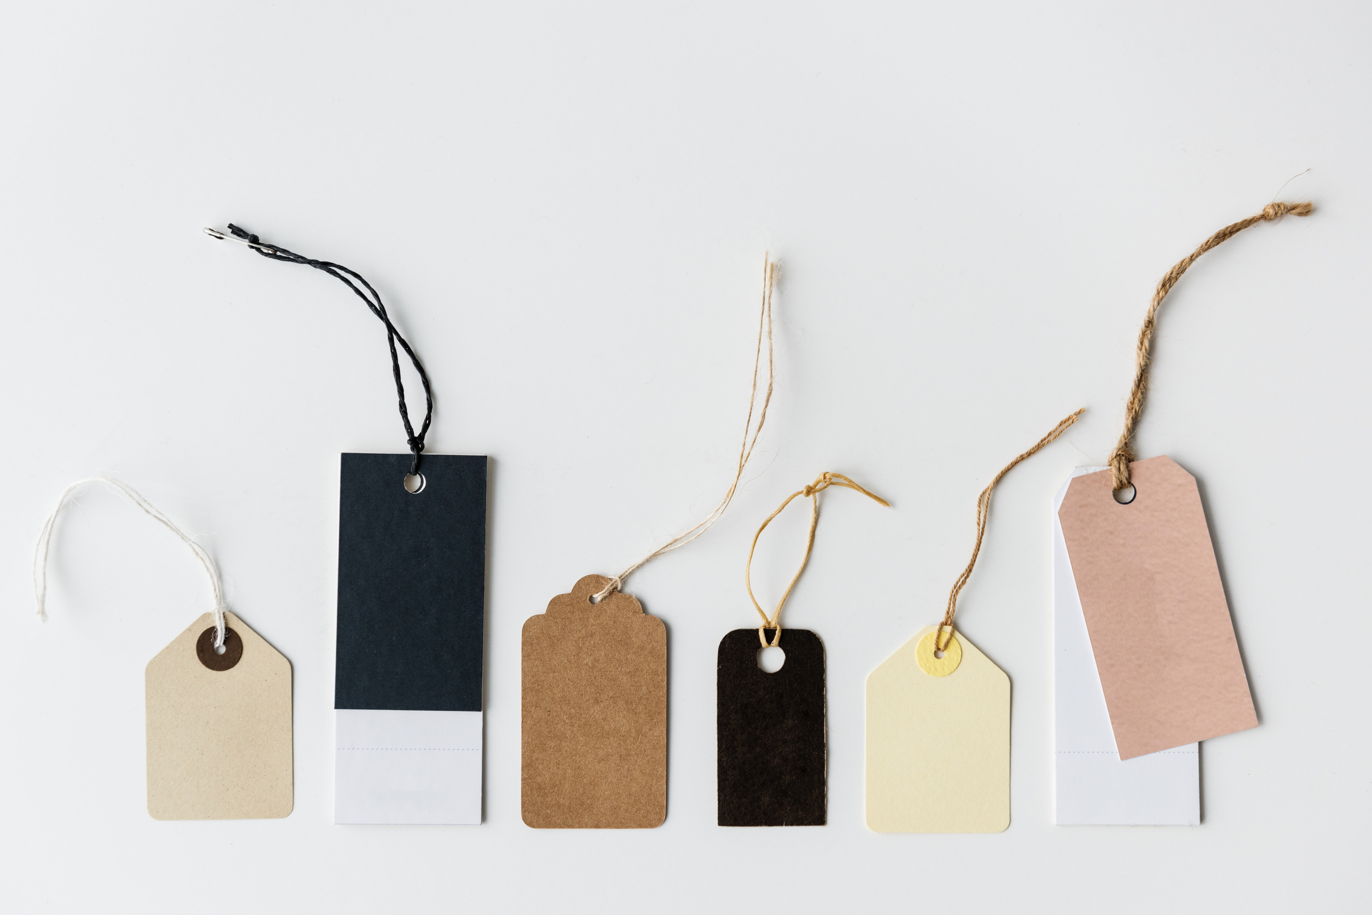
Notes:
We all are wearning paper badges but that is a bit old fashioned for a programming event. We should each make an electronic name badge…

Slide 26
Name Badge
from microbit import *
display.scroll(‘hi')
Notes:
Note opening and closing quotes come in pairs ‘ and “ are the same.
be careful of spelling, case, punctuation and spacing (indenting)
Flash and watch yellow light. Program starts immediately

Slide 27
Notes:
Watch yellow button on the back

Slide 28
Name Badge
from microbit import *
greeting = ‘hi my name is’
name = ‘chris’
display.scroll(greeting)
display.scroll(name)
Notes:
Change the name to your own and re-flash
Variables! One thing to change and the rest of the program works for everyone.

Slide 29
from microbit import *
greeting = ‘hi’
name = ‘Chris’
age = 15
display.scroll(greeting)
display.scroll(“My name is”)
display.scroll(name)
display.scroll(“I am”)
display.scroll(str(age))
Notes:
Notice the age is a number. We can convert using the str function to change it to text.

Slide 30
Name Badge
display.show(Image.HAPPY)
sleep(5000)
display.show(Image.ASLEEP)
Notes:
Delays
Pre-built images. List is quite long, try some different ones.

Slide 31
A few times…
for times in range(0, 3):
display.show(Image.HAPPY)
sleep(1000)
display.show(Image.ASLEEP)
sleep(1000)
display.scroll(‘done’)
Notes:
Notice indenting and does loop 3 times. Colon at the end of for

Slide 32
Forever
while True:
display.show(Image.HAPPY)
sleep(1000)
display.show(Image.ASLEEP)
sleep(1000)
display.scroll(‘done’)
Notes:
Notice indenting, colon and never comes back from this loop.
True is a proper name, must be this case.
Code put at the end of the loop never executes

Slide 33
Acclerometer
Notes:
Like in a mobile phone - knows about left, right, up down.

Slide 34
Accelerometer
x_tilt = accelerometer.get_x()
y_tilt = accelerometer.get_y()
display.scroll(
“x: “ + str(x_tilt)
“y: “ + str(y_tilt))
Notes:
Don’t try this - complicated - there is an easier way…

Slide 35
Notes:
using gestures

Slide 36
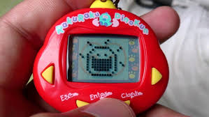
Notes:
With gestures we can build a cyber pet. New tab, don’t forget the import statement at the top !!!

Slide 37
Cyber-Pet
from microbit import *
while True:
if accelerometer.was_gesture("shake"):
display.show(Image.HAPPY)
sleep(5000)
else:
display.show(Image.ASLEEP)
Notes:
Notice if and colon and else and colon
Could also have elif:
# try ‘face up’ or ‘face down’

Slide 38
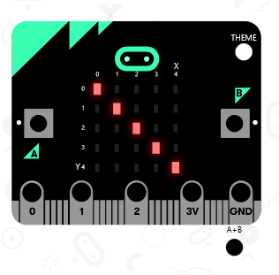
Notes:
We can make our own images to show on the name badge or on the cyber pet.

Slide 39
Your Image?
smiley = Image(
“00000:”
“09090:”
“00000:”
“90009:”
“09990”)
display.show(smiley)
Notes:
Custom images, brightness and shades of grey. Colons are important. Make your own picture.

Slide 40
Notes:
Can do simple animation on the display in a number of different ways.
Each frame is structured in a list to make it look like movement. We can do the same thing…

Slide 41
from microbit import *
small_heart = Image (“00000:05550:05650:05550:00000:")
big_heart = Image (“09090:99999:99999:09990:00900:")
heartbeat = [
small_heart,
big_heart,
small_heart,
big_heart,
small_heart,
small_heart
]
display.show(heartbeat, loop=True, delay=250)
Notes:
An example I made for my wife… list of images and display cycles through them, loop and delay between each frame

Slide 42
Buttons
from microbit import *
while True:
if button_a.was_pressed():
display.scroll('A')
elif button_b.was_pressed():
display.scroll('B')
sleep(100)
Notes:
is_pressed vs was_pressed? timing
Note extra indenting - two levels here.
Plate spinning - sleep is there to let microbit process some background and look at the button events.

Slide 43
Notes:
Including everything makes for big programs, need to be selective and use only what we need. Import
Imports go at the top of our program before anything else.

Slide 44
Randomness
import random
words = [‘one’, ‘two’, ‘three’]
word = random.choice(words)
display.scroll(word)
Notes:
Import random - not used otherwise - right at top, don’t forget import microbit.
List, picks one of a list. [ in pairs ] list comma delimited. Can change content of words but without having to change the rest of the program.

Slide 45
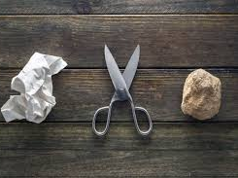
Notes:
Now have all the knowledge you need to make a rps game.

Slide 46
rock = Image(“00000:”
”09990:”
”90009:”
”92229:”
”29992")
choices = [ first, second, third ]
pick = random.choice(choices)
accelerometer.was_gesture("shake"):
Notes:
hints

Slide 47
from microbit import *
import random
rock = Image("00000:09990:90009:92229:29992")
paper = Image("99950:90992:90092:90092:99992")
scissors = Image("90009:09090:00900:55055:55055")
choices = [ rock, paper, scissors ]
while True:
if accelerometer.was_gesture("shake"):
rpors = random.choice(choices)
display.show(rpors)
sleep (3000)
display.clear()
Notes:
Import random - not used otherwise
List, picks one of a list. [ in pairs ] list comma delimited. Can change content of words but without having to change the rest of the program.

Slide 48
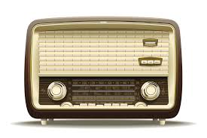
Notes:
Radio is one of the most fun parts of the microbit

Slide 49
Radio
import radio
radio.on()
radio.send(‘hello’)
radio.receive()
Notes:
Radio is expensive, turn on when necessary. Send broadcasts to local area and receive receives from anyone. Must check message before using.
Twitter!!!

Slide 50

Notes:
so we can make a simple version of twitter that will work just in this room.

Slide 51
Radio
import radio
radio.on()
tweet = “hello”
while True:
if button_a.was_pressed():
radio.send(tweet)
received = radio.receive()
if received:
display.scroll(received)
Notes:
Radio is expensive, turn on when necessary. Send broadcasts to local area and receive receives from any one. Must check message before using.
Twitter!!!

Slide 52
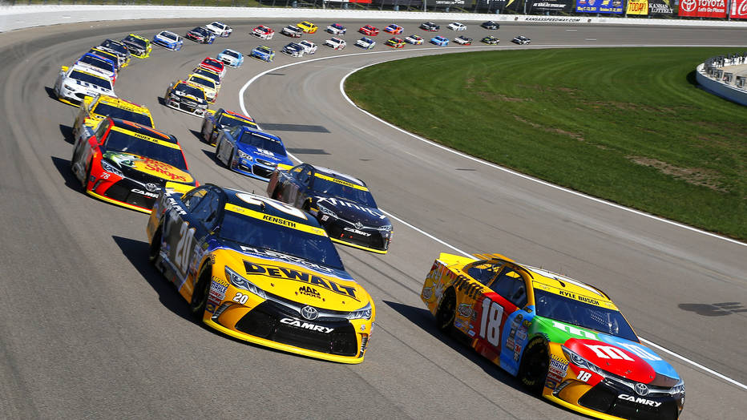
Notes:
We can put all we now know into making a racing game. Not cars, the display is so small we will be racing virtual fleas.

Slide 53
from microbit import *
flea = [0, 0]
Notes:
Import first
Model flea as a list of coordinates - x and y, starting at top left.

Slide 54
from microbit import *
flea = [0, 0]
display.set_pixel(flea[0], flea[1], 9)
Notes:
Show flea at its current position.
flea[0] is first thing in list - x, [1] is y value

Slide 55
from microbit import *
flea = [0, 0]
while True:
display.set_pixel(flea[0], flea[1], 9)
sleep(500)
display.set_pixel(flea[0], flea[1], 0)
sleep(500)
Notes:
We can make the flea flash by turning the pixel on and off
Change sleep values to make it faster or slower

Slide 56
from microbit import *
flea = [0, 0]
display.set_pixel(flea[0], flea[1], 9)
for x in range(1, 4):
display.set_pixel(flea[0], flea[1], 0)
flea[0] += 1
display.set_pixel(flea[0], flea[1], 9)
sleep(500)
Notes:
now let’s move it across the screen.
Replace while with a range to give us four places to move to.
Adjust sleep to change the speed.

Slide 57
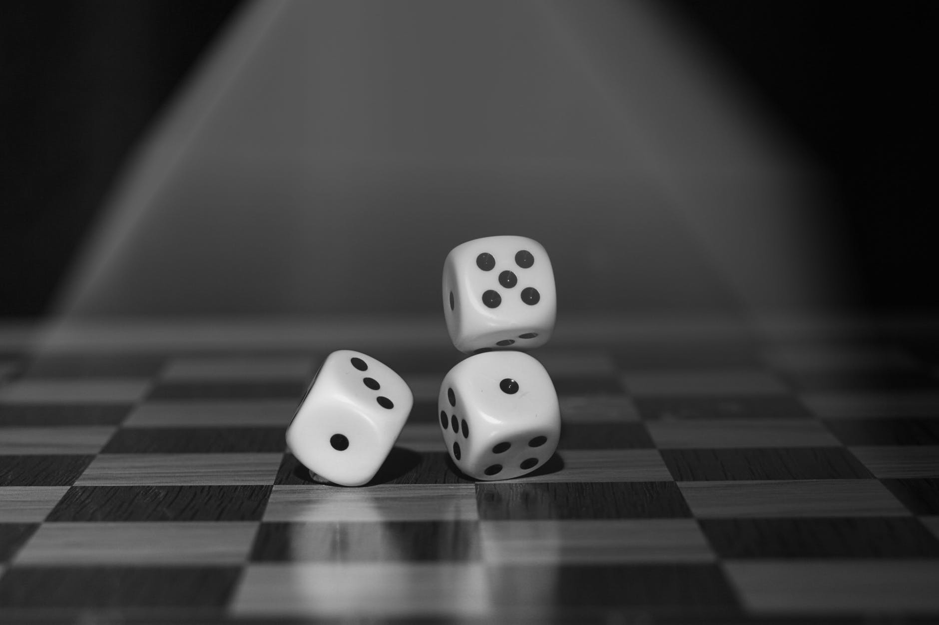
Notes:
Same thing happens all the time, would be nice to make it different every time.

Slide 58
from microbit import *
import random
flea = [0, 0]
display.set_pixel(flea[0], flea[1], 9)
for x in range(1, 10):
if random.randint(0, 1) == 1:
display.set_pixel(flea[0], flea[1], 0)
flea[0] += 1
display.set_pixel(flea[0], flea[1], 9)
sleep(500)
Notes:
Range has to be increased because we don’t move every time.
Random randint 0, 1 gives us 50% chance.

Slide 59
Error !!!!!
Notes:
There’s a problem with this code…
Moving too far to the right means we move off the screen
We need to keep it on the screen at the end.

Slide 60
from microbit import *
import random
flea = [0, 0]
display.set_pixel(flea[0], flea[1], 9)
for x in range(1, 10):
if random.randint(0, 1) == 1:
display.set_pixel(flea[0], flea[1], 0)
flea[0] += 1
flea[0] = min(flea[0], 4)
display.set_pixel(flea[0], flea[1], 9)
sleep(500)
Notes:
Range has to be increased because we don’t move every time.
Random randint 0, 1 gives us 50% chance.

Slide 61
from microbit import *
import random
flea = [0, 0]
runners = [ flea ]
for runner in runners:
display.set_pixel(runner[0], runner[1], 9)
Notes:
A race with one flea isn’t much of a race, so let’s build a list of racers - with just our original flea for the time being. Let’s change the top code to this

Slide 62
for x in range(1, 10):
for run in runners:
if random.randint(0, 1) == 1:
display.set_pixel(run[0], run[1], 0)
run[0] += 1
run[0] = min(run[0], 4)
display.set_pixel(run[0], run[1], 9)
sleep(500)
Notes:
And the while code to this…
Note extra for loop for all runners and name change in rest of code.
Be careful of extra indenting. Make sure sleep stays at original level otherwise raise will slow down!

Slide 63
#flea = [0, 0]
alice = [0, 0]
bob = [0, 1]
carol = [0, 2]
dave = [0, 3]
eleanour = [0, 4]
runners = [alice, bob, carol, dave, eleanour]
Notes:
Now we are set up to add more flea racers to the list of runners (and don’t need to change any of the other code.
Make sure each flea starts off at x = 0 but has a different value (0..5) for their y value - that way they all start off at the left and no one treads on anyone else.

Slide 64
Cheating?
Notes:
How could we improve the game? Add cheating?
Each flea could have an extra value which is their probability of moving.

Slide 65
alice = [0, 0, 1]
bob = [0, 1, 5]
carol = [0, 2, 10]
dave = [0, 3, 6]
eleanour = [0, 4, 9]
..
if random.randint(0, run[2]) == 1:
Notes:
flea[2] is the probability. A low score means a higher likely hood of moving (and winning). 1/2 for alice compared to 1/10 for eleanour.

Slide 66
What else?
Notes:
What else could we do to improve the game?

Slide 67

Tuesday
Notes:
Tomorrow we will be looking at building a minecraft app on the laptops.

Slide 68
Functions
def say_something():
display.scroll(‘hi’)
say_something()
Notes:
Reusable chunks of code
Must come first before being used so python sees them and puts them away
Arguments
Return values

Slide 69
Functions
def say_something(message):
display.scroll(message)
say_something(‘hey’)
say_something(‘hi’)
say_something(‘hello’)
Notes:
Reusable chunks of code
Arguments
Return values

Slide 70
Functions
def is_it_bob(name):
return name == “bob”
if is_it_bob(person_name):
display.scroll(‘hi bob’)
Notes:
Reusable chunks of code
Arguments
Return values

